Slide 1
Software Engineering Management
Main issues:
Plan - as much as possible, but not too much, up front
Control - continuously

Slide 2
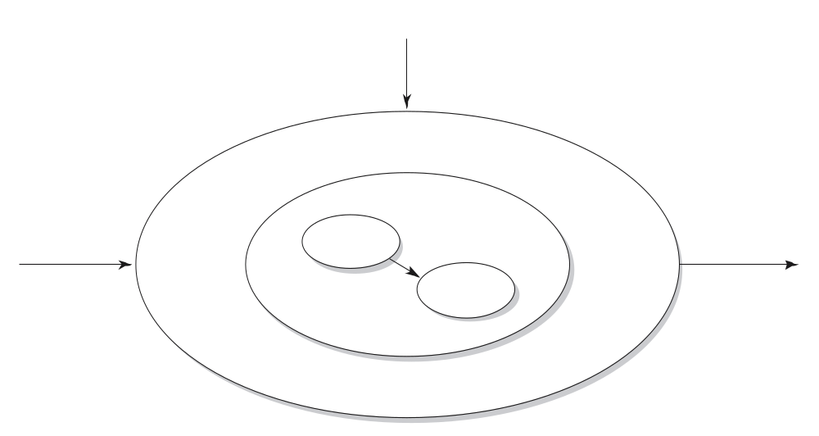
A broader view on software development
information planning
boundary conditions
documentation
people
software
input
program
output
program
procedures
©2008 John Wiley & Sons Ltd.
www.wileyeurope.com/college/van vliet
Notes:
© SE, Management, Hans van Vliet

Slide 3
Example: information plan of a university registration of student data
Relations to other systems: personal data, courses, course results, alumni, …
Use both by central administration, at faculty level, and possibly by students themselves
Requires training courses to administrative personnel
Authorization/security procedures
Auditing procedures
External links, e.g. to scholarship funding agencies, ministry of education
©2008 John Wiley & Sons Ltd.
www.wileyeurope.com/college/van vliet

Slide 4
Contents of project plan
Introduction
Process model
Organization of project
Standards, guidelines, procedures
Management activities
Risks
Staffing
Methods and techniques
Quality assurance
Work packages
Resources
Budget and schedule
Changes
Delivery
©2008 John Wiley & Sons Ltd.
www.wileyeurope.com/college/van vliet
Notes:
© SE, Management, Hans van Vliet
Process model = life cycle model
Organization: relationships to other parts of the organization, roles of people, user involvement
Risks: e.g. hardware not in time, critical information to be provided by customer
Staffing: different amounts of people needed at different points in time
Work packages: work breakdown structure
Changes: procedures on how to handle them

Slide 5
Project control
Time, both the number of man-months and the schedule
Information, mostly the documentation
Organization, people and team aspects
Quality, not an add-on feature; it has to be built in
Money, largely personnel
©2008 John Wiley & Sons Ltd.
www.wileyeurope.com/college/van vliet
Notes:
© SE, Management, Hans van Vliet

Slide 6
Managing time
Measuring progress is hard (“we spent half the money, so we must be halfway”)
Development models serve to manage time
More people ⇒ less time?
  Brooks’ law: adding people to a lae project makes it later
©2008 John Wiley & Sons Ltd.
www.wileyeurope.com/college/van vliet

Slide 7

Managing information
Documentation
  Technical documentation
  Current state of projects
  Changes agree upon
  …
Agile projects: less attention to explicit documentation, more on tacit knowledge held by people
©2008 John Wiley & Sons Ltd.
www.wileyeurope.com/college/van vliet

Slide 8

Managing people
Managing expectations
Building a team
Coordination of work
©2008 John Wiley & Sons Ltd.
www.wileyeurope.com/college/van vliet

Slide 9

Managing quality
Quality has to be designed in
Quality is not an afterthought
Quality requirements often conflict with each other
Requires frequent interaction with stakeholders
©2008 John Wiley & Sons Ltd.
www.wileyeurope.com/college/van vliet

Slide 10
Managing cost
Which factors influence cost?
What influences productivity?
Relation between cost and schedule
©2008 John Wiley & Sons Ltd.
www.wileyeurope.com/college/van vliet

Slide 11
Summary
Project control concerns
  Time
  Information
  Organization
  Quality
  Money
Agile projects do less planning than document-driven projects
©2008 John Wiley & Sons Ltd.
www.wileyeurope.com/college/van vliet

